Slide 1


Placement Management system
By Praveena
(Under the guidance of Anjana Sarode)

Slide 2
Introduction
This Frontend project will focus on creating a placement management system
Frontend or client side web development refers to everything in a web application that is displayed on the frontend which users can see from the browser

Slide 3
Front-end Technology
HTML- Hyper Text Markup Language
- Structure of the pages

Slide 4
Objective
The project is focusing on the placement management system
This project have Admin, Student, Placement, College entities.
Admin entity is for login purpose and have a home page to connect with other entities

Slide 5
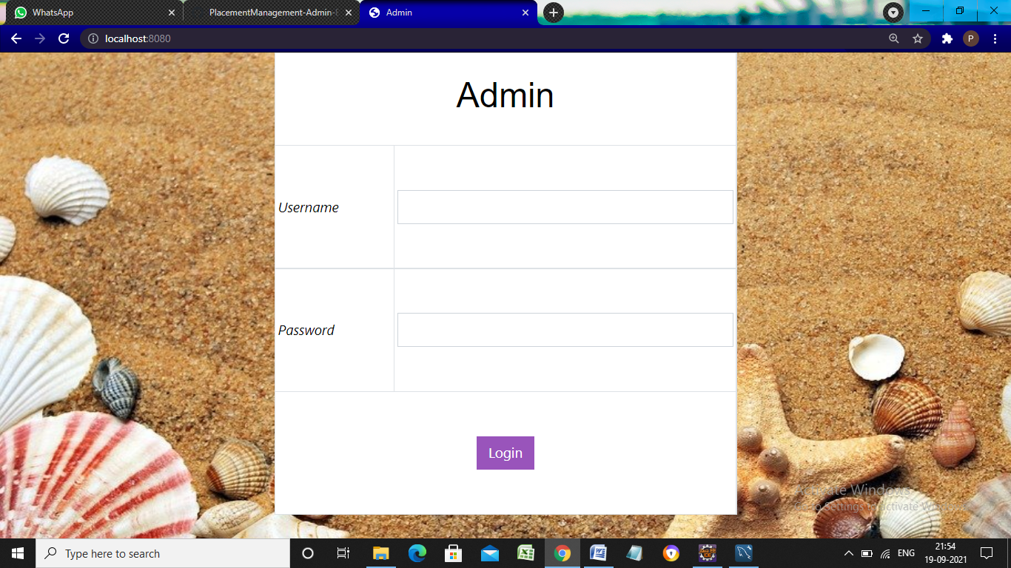

Slide 6
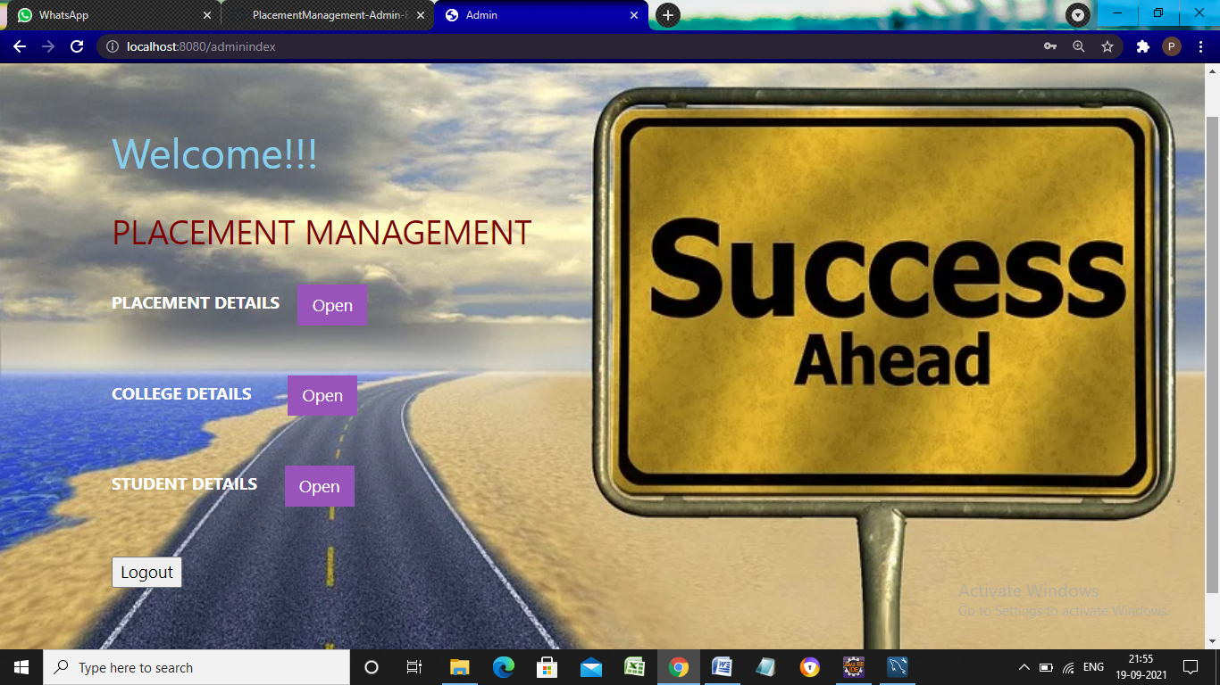

Slide 7
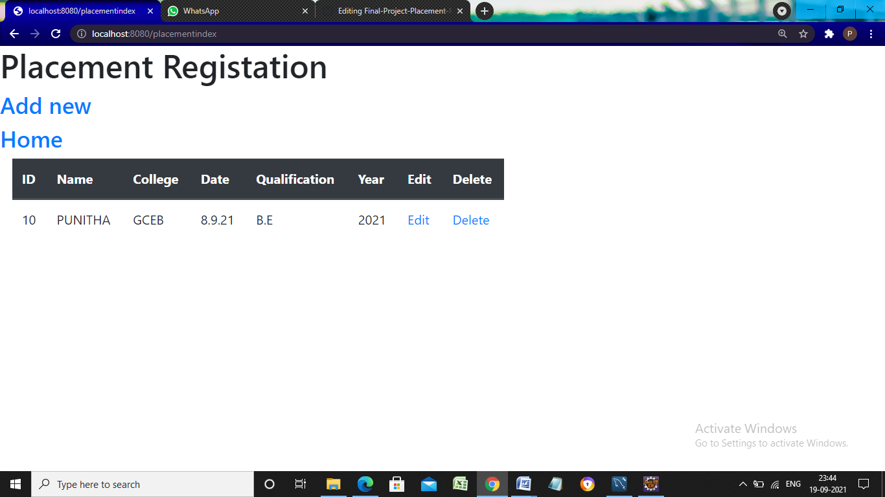

Slide 8
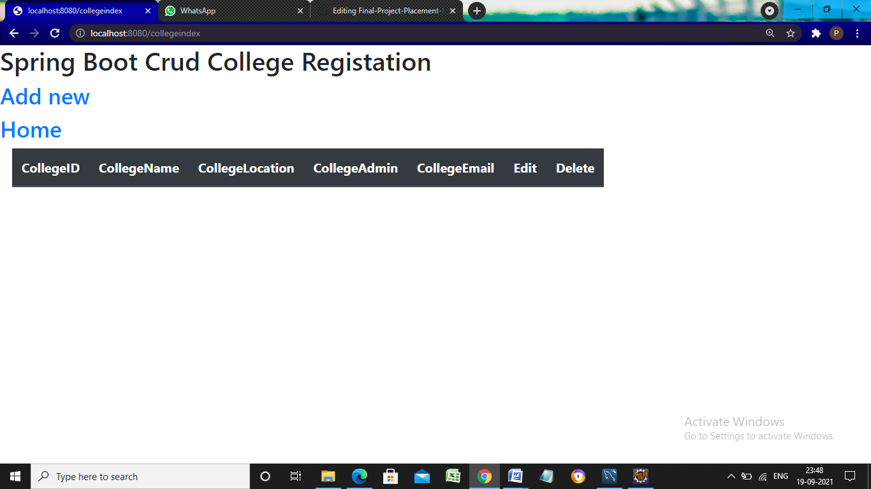

Slide 9
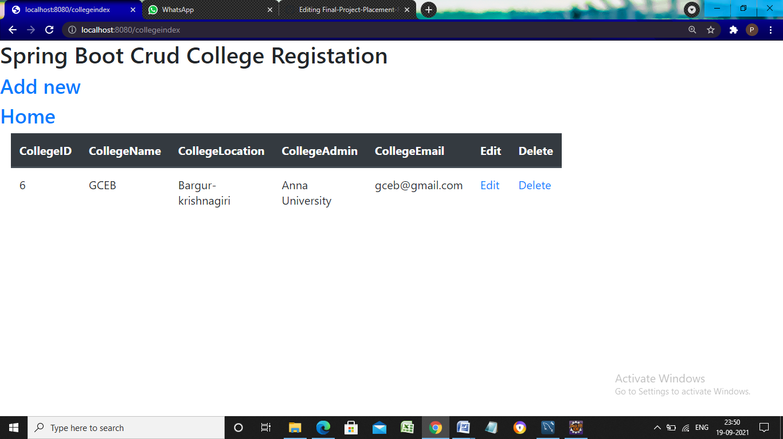

Slide 10
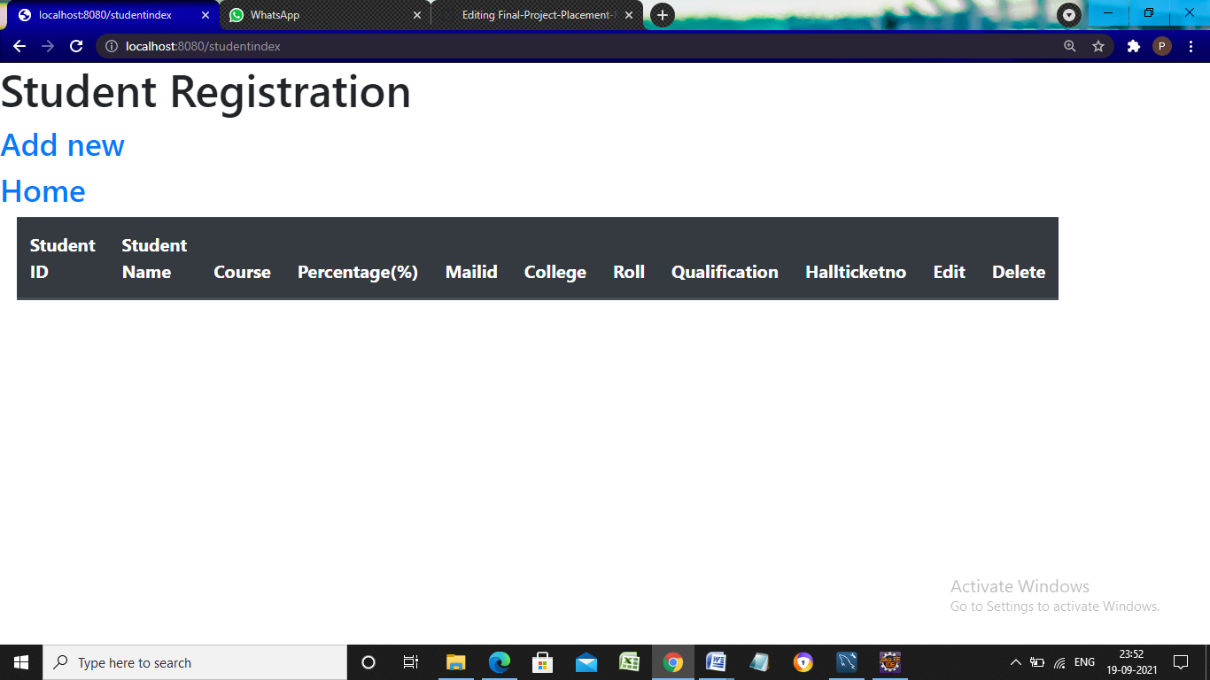

Slide 11
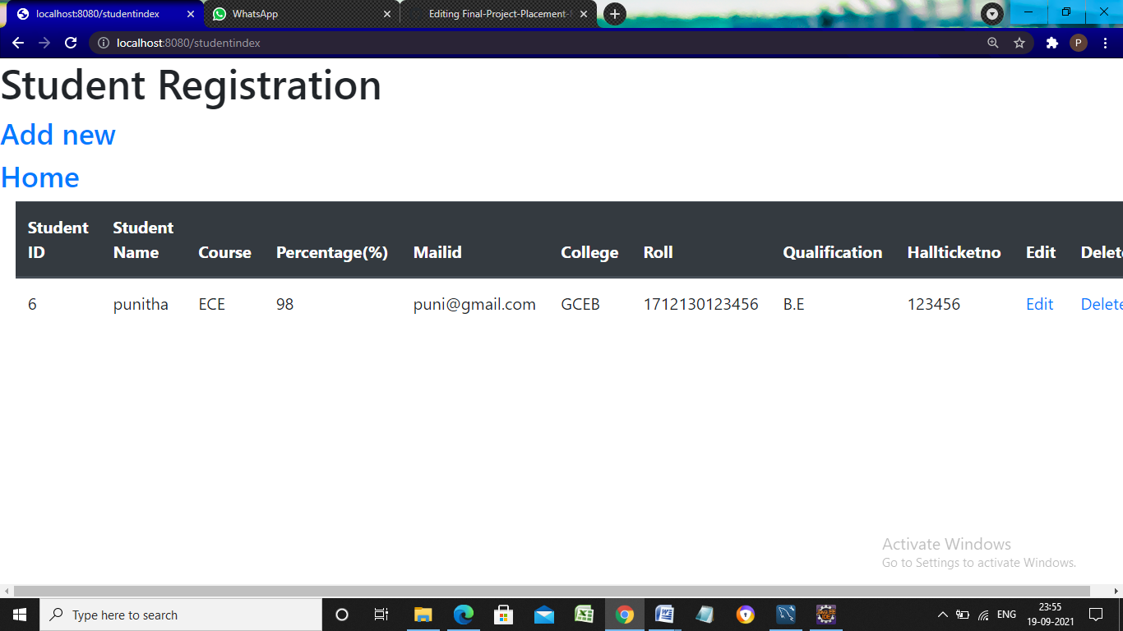

Slide 12


Thank you

